Slide 1
The Duel for North America
1608-1763

Slide 2

France Finds a Foothold in Canada
Led by Samuel de Champlain-France
established good relationships with the Huron Indian tribes, he entered into a Treaty with them against the Iroquois.
King Louie XIV (14th) took a much bigger interest in colonizing the “New World”.
The French territory is ruled directly by the King of France,
the people had very few freedoms in “New France”/Louisiana (autocracy)
What were the French after?

Slide 3
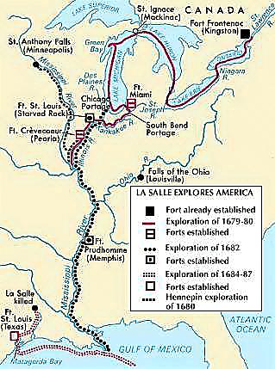
New France Fans Out
Robert de La Salle (coureurs de bois) floats down the Mississippi in 1682, and reaches the Gulf of Mexico
He names this new area “Louisiana” after King Louis XIV.
Along the way the French fortified their posts, most notably New Orleans (1718) this becomes important later.
Control the mouth of the Mississippi River Valley (MRV)

Slide 4
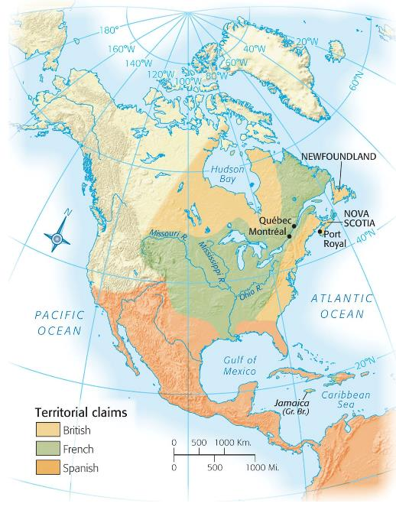
The Clash of Empires
King William’s War (1689-1697) Queen Ann’s War (1702-1713) both wars were British colonists vs. French colonists.
The French colonists (with aid from the Spanish) and British colonists fight against each other with their Indian allies.
Without military support from their mother countries; it “wasn’t worth the commitment.”
Results: Britain was awarded French-populated Nova Scotia, Newfoundland, and Hudson Bay (Treaty of Utrecht, 1713)
Problem: 1) France’s settlements become pinched by the St. Lawrence River. 2) Britain provides colonies with 10 yrs. of salutary neglect – fertile soil for roots of independence.

Slide 5
The Clash of Empires cont.
The War of Jenkin’s Ear 1739.
Between the British and Spanish over smuggling in Caribbean and Georgia
British Captain Jenkins has an ear sliced off by the Spanish.
King George’s War (escalation of the war of Jenkin’s Ear)
France allied with the Spanish, again British and French colonists fight, including in Louisbourg.
When the fighting ends, Louisbourg is handed back to the French, the New England Colonists are upset by this.

Slide 6
George Washington Inaugurates War with France
The Ohio River Valley became the chief area of contention between the French and the British.
For the British it was critical for westward expansion
For the French it was key to link their Canadian holdings to the MRV.
The French have been busy fortifying their forts, one in particular: Fort Duquesne (Pittsburg).
George Washington marches on the fort, but is ultimately defeated and forced to surrender in 1754 (on the 4th of July!).

Slide 7
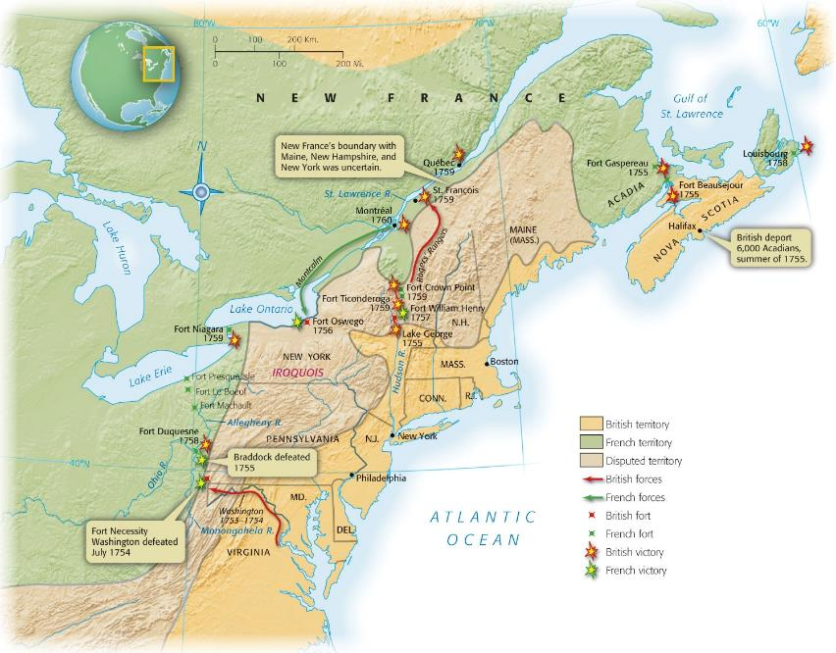
George Washington Inaugurates War with France

Slide 8
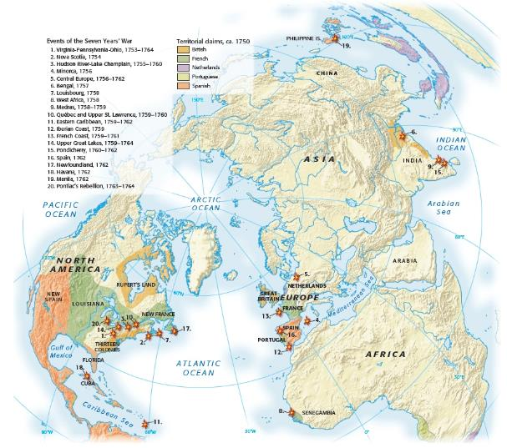
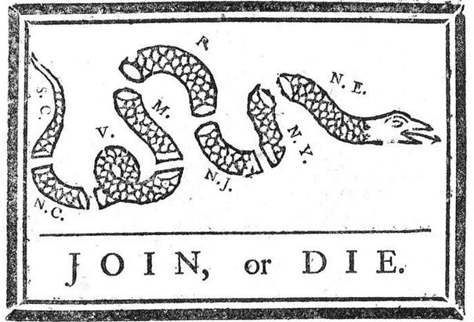
Global War on Colonial Disunity
The French and Indian War (not the French and Indians fighting; but the French and Indians fighting against the British) AKA The Seven Years’ War
Some of the most significant fighting took place in Germany.
A large scale world war, with battles across Europe
In 1754, representatives from 7 of the 13 colonies met in Albany, New York to discuss a more colonial unity – known as the Albany Congress

Slide 9
Braddock’s Blundering and Its Aftermath
Early in the war, the British in America, and the British colonists, were wildly unsuccessful, including a second unsuccessful attempt to take Fort Duquesne.
Much of the faults had to do with poor strategy and planning.

Slide 10
Pitt’s Palms of Victory
The British appoint William Pitt to lead the war from London.
The Battle of Quebec in 1759 was a major turning point in the war, when the British defeat the French.

Slide 11
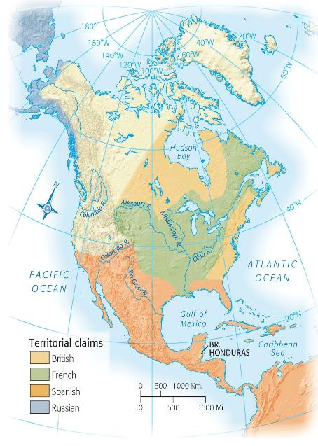
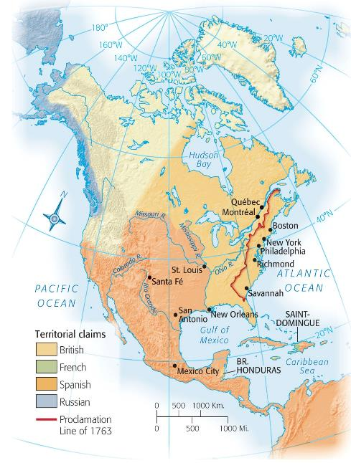

Slide 12
Restless Colonists
The French and Indian War gave the colonists increased confidence and experience, while at the same time made them realize the British regulars were invincible.
Tension arose as well, as some of the colonists refused to help in the war effort, and some even aided the French and Spanish during the war.
Soldiers had shared experiences and similarities despite being from different colonies.

Slide 13
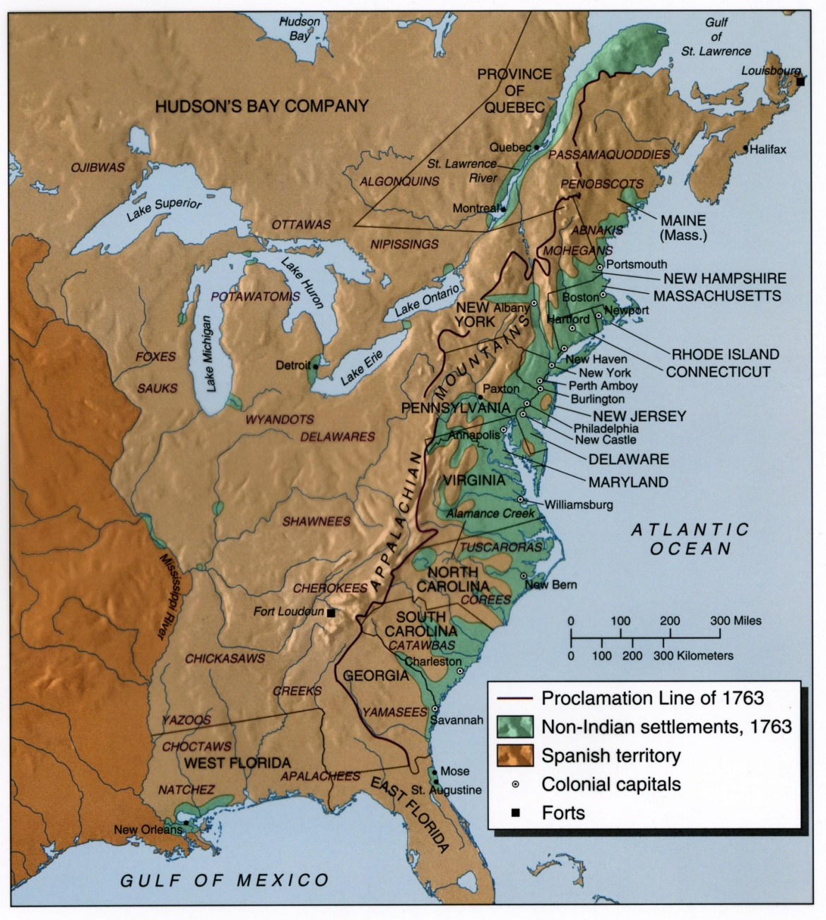
War’s Fateful Aftermath
Pontiac’s uprising: following the war, Native American’s looked to improve their situation, and Chief Pontiac lead an uprising in the Ohio Valley doing quite well.
To stop the uprising the British used biological warfare, giving them blankets infected with small pox.
Because of this, the British decide to keep troops stationed along the frontier and stabilize relations.
Proclamation line of 1763: No colonial settlement beyond the Appalachian Mountains.
Was it fair?

